Slide 1


SEG3125: Lab 7
Designing a website of your choice – Part 1
Presented by TA Gurdarshan
Faculté de génie | Faculty of Engineering
uOttawa.ca

Slide 2
Deadlines
The deadline for lab 7 is March 10th at 11:59PM
This lab is worth 3%

Slide 3
Introduction
3
This lab, you are going to design a website of your choice
You are going to focus on Heuristic Evaluation
You are also going to think about Human Interactive Processes
No actual coding in this lab
This lab if the part 1 of three labs (Lab 8 and 9) where you are going to be working on the same website.

Slide 4
Lab 7 Introduction
This laboratory is different from the previous ones
You are going to create a website of your choice that reflect what you learned so far.

Slide 5
Heuristic Evaluation

Slide 6
Heuristic Evaluation
Consistency
Consistency in colors and fonts
Standard icons

Slide 7
Heuristic Evaluation
Familiar language and metaphors
Are the icons self explanatory ?
Is the wording understandable to most user ?

Slide 8
Heuristic Evaluation
Simple, aesthetic and functional design
Think about:
Simplicity
Colors
Screen real estate
Font-size
How does the website attract the user's attention?

Slide 9
Heuristic Evaluation
Freedom and control
Are you free to do actions and cancel them?
The user has to feel in control

Slide 10
Heuristic Evaluation
Flexibility
Shortcuts for expert user but menus for new users
Different ways to get to certain part of the website

Slide 11
Heuristic Evaluation
Recognition over recall
Avoid abbreviations
Don't assume people will remember the options (reminder), but make sure the functions and options are clear (recognition) on the screen.

Slide 12
Heuristic Evaluation
Clear Status
When you go to a page, does it clearly show what option (or what step) you're in?
What is the next step?
Completion of the process: show the user that he is done his task (Order completed message)

Slide 13
Heuristic Evaluation
Error Prevention
What's going to happen?
Use feedback messages to alert users of the possible consequences of their actions
Oh ... I don't want to continue... how can I get out of here?
Provide exit (undo / go back)
How can I enter this information?
Add input constraints
Am I going to lose my progress?
Use a state save (auto save)

Slide 14
Heuristic Evaluation
Error recovery
Make you as your error message sounds like if it had been written by a human
Make you as your error message can be easily seen.
Make you as your error message explains clearly what happened, that it is neither encrypted nor too vague.

Slide 15
Heuristic Evaluation
Help
Help at different levels
Global help (global process)
Contextual help (on buttons)
Provide tutorials, except if it’s a "walk up and use" application that should be clear without additional documentation
Make access easy for beginners
Provide an introduction (guided tour) of the software for first time users

Slide 16
Human Interactive Processes
Following instructions
Absorb information
Monitored activity
Exploring
Analyzing results
Production/Design
Communicating
Planning

Slide 17
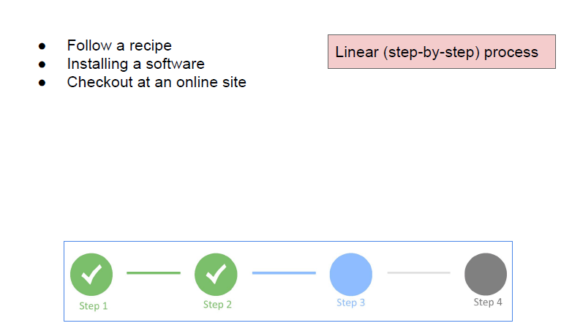
Following instructions

Slide 18
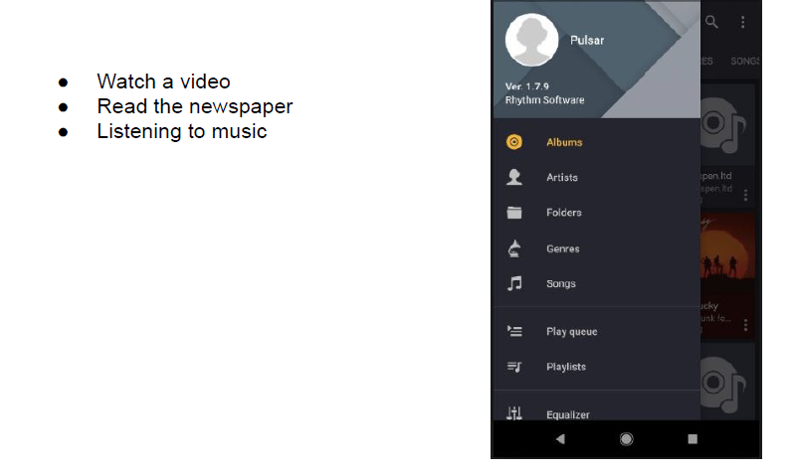
Absorb information

Slide 19
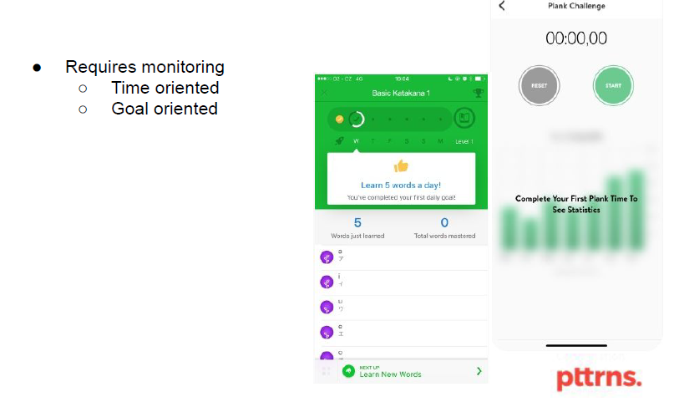
Monitored activity

Slide 20
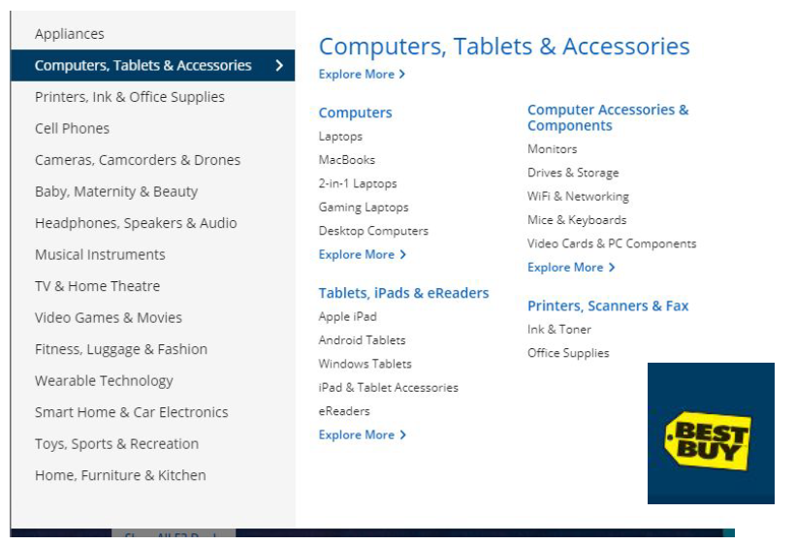
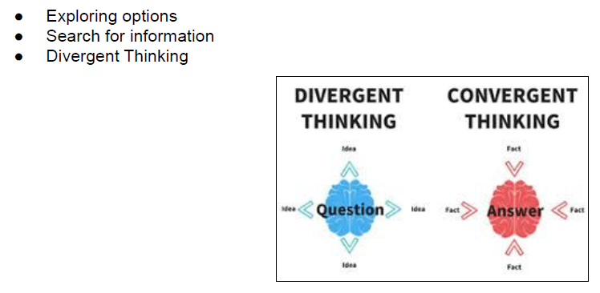
Exploring

Slide 21
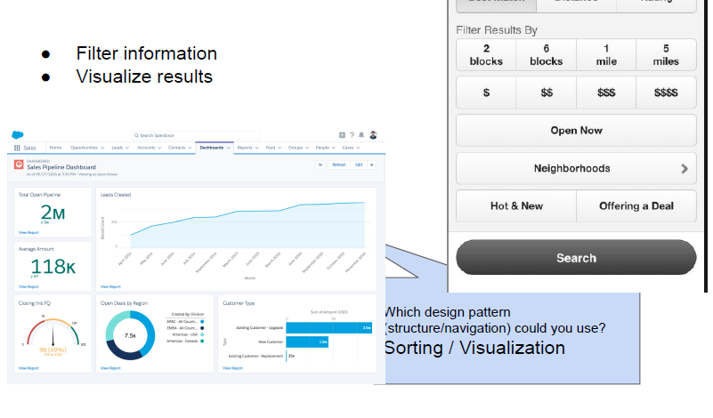
Analyzing results

Slide 22
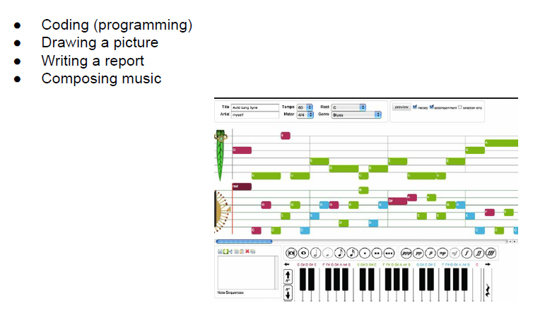
Production/Design

Slide 23
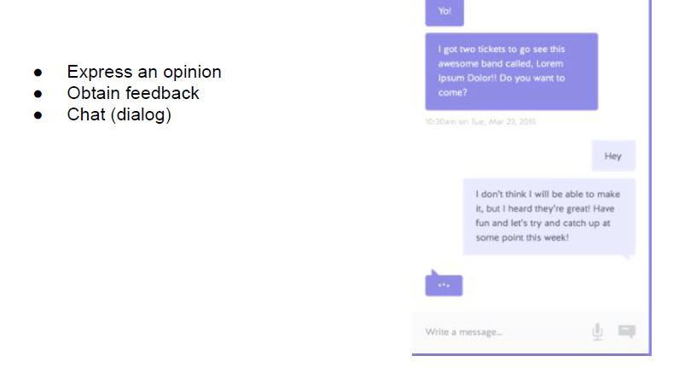
Communicating

Slide 24
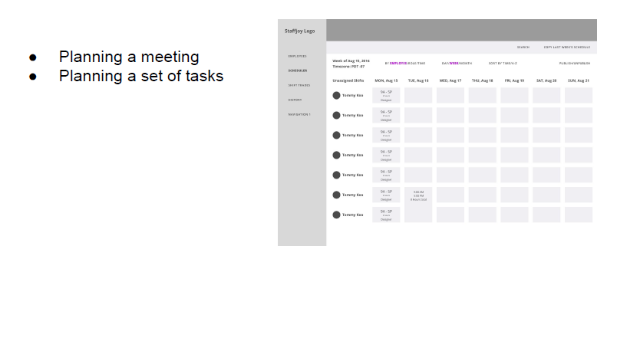
Planning

Slide 25
Requirements
Choose a name for your website
Choose a domain/service for your website
Make a sketch/prototype for each process. Name these so you can refer to them in your report

Slide 26
Report’s Requirements
Description of your website’s purpose
Present a semantic network and how you are going to present the different concepts in your website
Explain which human interactive processes will be put forward (at least 3).
For each usability heuristic (10 heuristics): Explain what design element of a sketch/prototype is related to this heuristic.

Slide 27
Starting point
No starting point

Slide 28
Submission
You will need to submit :
Your report (including prototypes)

Slide 29

Questions
18
Any questions???
If you have any question, you can send me an email to TAs

Slide 30
THANK YOU!

